Slide 1
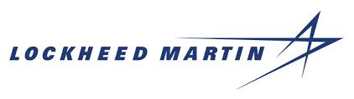
From Value Streams to Agile Teams
June 2020
Robin Yeman
Lockheed Martin Corporation
Robin.Yeman@lmco.com
Dr. Suzette S. Johnson
Northrop Grumman Corporation
Suzette.Johnson@ngc.com
Notes:
Abstract: ‎As Agile and DevOps practices continue to challenge the status quo and improve business outcomes, large companies need to learn how to scale these practices across large, complex systems composed of hardware, firmware, and software. The ability to iterate and deploy faster requires companies to adapt to changing needs, reduce cycle time for delivery, increase value for money, and leverage innovations. An industry-wide misconception is that this form of rapid iteration is only for software or small applications and systems. For large cyber-physical solutions, software is only one part of the value stream leading us to consider the implication and the application of Agile DevOps principles across the entire end-to-end flow. When adopting Agile and DevOps principles to developing products it is important to understand flow of value throughout the value stream and to identify the constraints within the system.
In our previously published DevOps Enterprise Forum papers from 2018-2019 Industrial DevOps: Applying DevOps and Continuous Delivery to Significant Cyber-Physical Systems, we described a set of principles that development organizations can use to bring the power of Agile and DevOps to the build and maintenance of large-scale, cyber-physical systems such as vehicles, robots, complex medical devices, defense weaponry, and others. We introduced the term “Industrial DevOps” to expand the definition of DevOps in order to enable significant, cyber-physical system development programs to be more responsive to changing needs while also reducing lead times.
In this presentation, we will demonstrate the importance of Industrial DevOps, systems thinking and value stream identification to understand flow, theory of constraints, and organizing around value. We will share lessons that take us from value stream identification to building teams in this new way of working. We will also share lessons for building teams that includes an environment where we create a learning and collaboration culture.
These concepts and examples build off the Industrial DevOps papers, which have been published in coordination with IT Revolution (Gene Kim) and co-authored with Northrop Grumman, Lockheed Martin, Xebia Lab, Scaled Agile Inc., and other companies from industry.
Learning Objectives:
Apply systems thinking by looking across the value stream and what this means for solutions including hardware and software teams
Understand the importance of value stream mapping
Share ways for building the skills, knowledge, and experience of the workers in a high collaborative environment

Slide 2
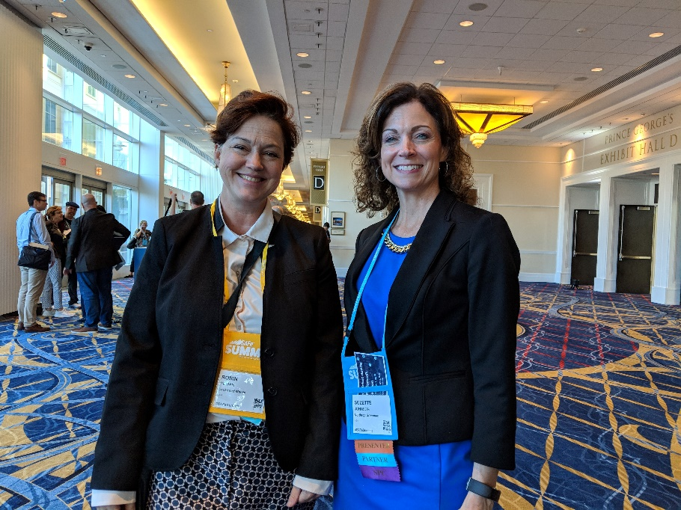
Introductions
Robin Yeman
Suzette Johnson

Slide 3
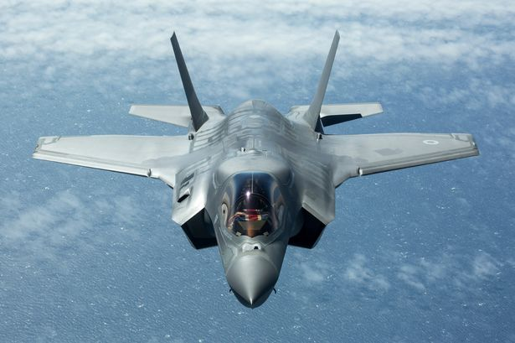
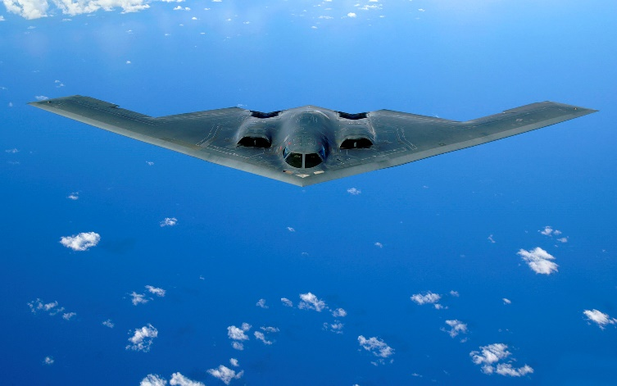
Industrial DevOps Applied
Companies like Lockheed Martin and Northrop Grumman build life human safety critical like F-35 and the B-2
F-35
B-2
Notes:
Two companies with similar products and services enabling them to experience similar challenges

Slide 4
Problem statement for large organizations
System Context
Cultural Context
System Structure
Quantitative Information Flow
Heterogeneous Elements
Emergent behavior
Interfaces
Nomenclature
Organizational Structure
Qualitative Information Flows
Heterogenous Subculture
Mental Models
Relationships
Language
Notes:
Either one of these problems are difficult independently, together they are incredible
This is a multi-dimensional problem

Slide 5
Industrial DevOps Principles
Visualize and organize around the value stream
Multiple Horizons of Planning
Base decisions on objective evidence of system state and performance
Architect for Scale, Modularity, and Serviceability
Iterate / Reduce batch size / Get fast feedback
Cadence and Synchronization
Continuish Integration
Test Driven Development
“DevOps is a mixture of people, process, and technologies that provides a delivery pipeline enabling organizations to move both responsively and efficiently from concept to business outcome.” - Robin Yeman
© 2020 LOCKHEED MARTIN CORPORATION
© 2020 Northrop Grumman Systems Corporation
Notes:
These are Common principles when implementing industrial DevOps, It is interesting that each of these can be viewed from a system or a cultural context.

Slide 6
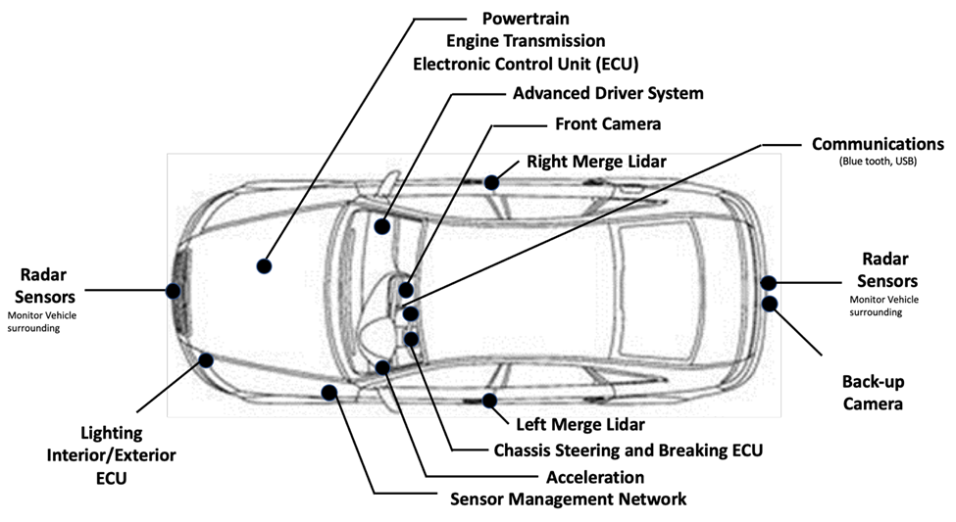
Example: Autonomous Vehicle
Autonomous vehicles have similar complexity and human safety details as many of the products that Lockheed Martin and Northrop Grumman currently do.
System Context
Cultural Context
Notes:
We are working with a complex system of systems, The culture and organization is part of the greater system.
Even the simplest organizational structure introduces complexity, but many large companies introduce matrix
Organizations. We need to architect the system and the culture

Slide 7
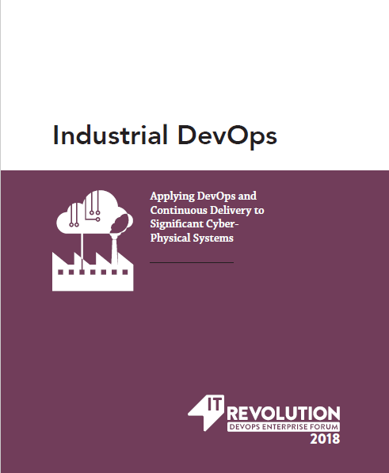
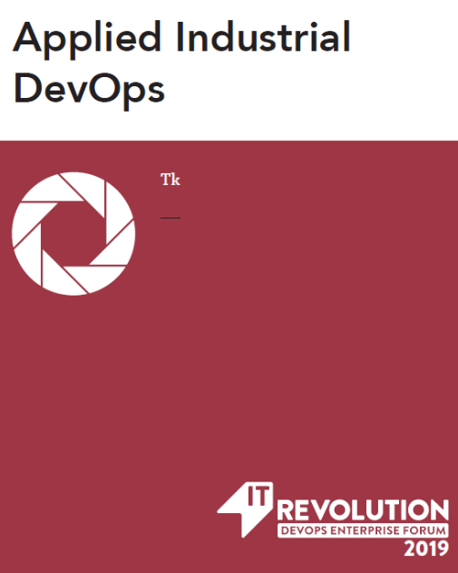
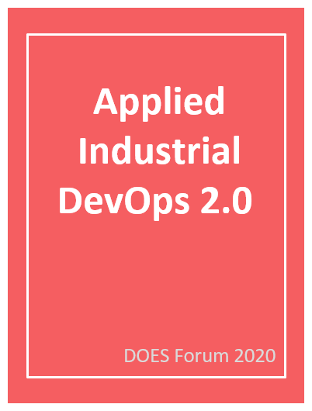
Continuing the Industrial DevOps journey
Industrial DevOps expands the definition of DevOps outside of software to enable significant cyber-physical systems development programs to be more responsive to changing needs while reducing lead times.
It is the application of continuous delivery and DevOps principles to the development, manufacturing, deployment, and serviceability of significant cyber-physical systems.
Value Streams
Systems Architecture
Cultural Architecture
2018
2019
2020
Defining the Principles
Applying the Principles
Applied Industrial DevOps 2.0
Coming soon…
https://itrevolution.com/book/industrial-devops//
https://itrevolution.com/book/applied-industrial-devops/
Notes:
In addition, we describe changes that Alset implemented to take advantage of the dynamic learning and feedback loops, as well as intentional culture architecture design to ensure that DevOps principles were embraced and gained lasting traction throughout the organization.

Slide 8
Scenario: Alset Transport
Business Goal: improve the collision-avoidance capability by increasing the obstacle-detection system’s actionable closing distance by 50% of the current operating distance
Apply Principle 1: “Visualize and Organize Around the Value Stream”
Epic | System Impact | Cultural Impact
Enhance obstacle-detection software or firmware in existing vehicles | Software | Multiple Suppliers and multiple teams within Active Safety Product line (Information Flow, Language, relationships)
Update camera and associated technology in future vehicles | Software, Firmware, Hardware | In addition to above, we have heterogenous subcultures and varied mental models
Notes:
Last year in Industrial DevOps applied we focused on the system and have seen that is not enough
As Alset moves to update their system to meet business goals, they realize they need to be intentional
about both architecting the system and the culture. This year we introduced Noel who is a technical leader at Alset.
When he implemented the technical changes to meet the goals outlined, he failed to include quality from operations excellence.
Although they were able to complete the changes on time, the teams were not allowed to ship.
From a customer perspective, Alset did not deliver and the key was bringing the organization with them

Slide 9
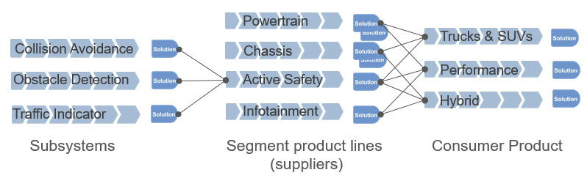
Alset Value Stream Identification (System Context)
Customer need/request
Delivered
Alset’s Autonomous vehicle has several “value streamlets” to consider
{
System Structure
Information Flows
Heterogenous Elements
Emergent Behavior
Multiple Interfaces
Varying nomenclature
Notes:
Apply systems thinking by looking across the value stream
As we looked at the Active Safety Product Line we were able to define updates to Collision Avoidance Value Stream.
This Development Value Stream delivers to the product lines.
The changes being made impact Hardware, Firmware, and Software with multiple interfaces
With the variety of heterogenous components the system is likely to experience emergent behavior, so things like automated test, digital twin, and chaos engineering are necessary.

Slide 10
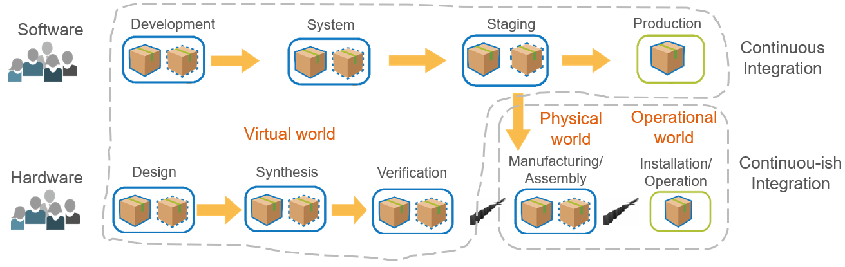
Alset Value Stream Identification (Cultural Context)
{
Organization Structure
Information Flows
Heterogenous Subcultures
Mental Models
Multiple relationships
Varying language
Alset’s Autonomous vehicle has several “teams” to consider
Notes:
All of the complexity of the System Context, is amplified in the cultural context
1. Varying Organizations with their own subcultures
2. Hardware, Firmware, and Software Engineers do not have the same mental model – In most cases even at University these majors would not interface with one another
3. Relationships between the groups will not be consistent
Reference Team Topologies p.86 who also references Accelerate (continuous learning and technical specialists (similar to SAFe’s shared services concept)
Create small, small long-lived teams who are cross functional
Align with the value streamlet with regular demonstrations of value
Architect to reduce handoffs

Slide 11



Architect the Product (System Context)
As Alset transitioned to apply Industrial DevOps across the system, it came to understand that many of the barriers to implementation stemmed from Alset’s legacy system structure.
Alset’s System Behavior Roadmap
Owner: Lean-Agile Leader
Q1
Q2
System Validation (System, Subsystem, Component)
Active Prototyping
Refactor w/ Strangler Pattern
Innovate
Validate ”AS IS” state at all system levels against business objectives
Design steel thread to move system to next desired state.
System
Define Prototypes to prove out multiple hypothesis
Leverage Set based design to reduce solution alternatives
Prototype
Use System Telemetry from pipelines to show where improvements are needed
Refactor areas of solution that need to be optimized or simplified.
Refactor
Develop Personas of key customers to understand what future needs they have.
Implement solution day pitches or challenges to continuously evolve.
Innovate
Notes:
The System should have a roadmap that is ever evolving to meet needs of stakeholders.
We should align roadmap cadence for System and Cultural

Slide 12
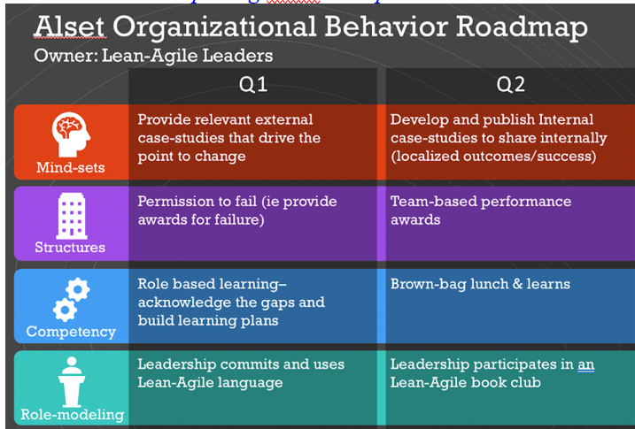
Architect the Culture (Cultural Context)
As Alset transitioned to apply Industrial DevOps across the organization, it came to understand that many of the barriers to implementation stemmed from Alset’s organizational culture.
Mind-set Validation
Org Surrounding Support Structure
Technical Competency
Active Role-modeling
Notes:
Reference Team Topologies (p. 67 Successful team patterns)
We will share lessons that take us from value stream identification to building teams in this new way of working. We will also share lessons for building teams that includes an environment where we create a learning and collaboration culture.
As Alset transitioned to apply Industrial DevOps principles and practices across the organization, it came to understand that many of the barriers to implementation stemmed from Alset’s organizational culture. According to Edgar Schein’s model for Organizational Culture (1980), an organization’s culture consists of both observable behaviors and processes (artifacts), as well as the unobservable espoused values and basic assumptions (Figure XYZ). Culture is not merely the “what” of how things are done but also the “why” such as the underlying beliefs.

Slide 13
Help We Are Looking For
Other examples of value streams for large cyber-physical solutions
How has your organization addressed leadership and cultural challenges for large transformations?
Information or stories on bridging the gap between manufacturing and development across different phases of the product life cycle

Slide 14
Contributors
Josh Atwell jatwell@splunk.com
Ben Grinnell ben.grinnell@northhighland.com
Dean Leffingwell, Co-founder and Chief Methodologist, Scaled Agile Inc.
Dr. Suzette Johnson, Fellow and Agile Transformation Lead, Northrop Grumman Corporation
Harry Koehnemann, SAFe Fellow and Principal Consultant, Scaled Agile Inc.
Vincent Lussenburg vlussenburg@xebialabs.com
Dr. Steve Mayner, SAFe Fellow and Principal Consultant, Scaled Agile Inc.
Robin Yeman, Lockheed Martin Fellow, Lockheed Martin Corporation
Joy Crook, Organization Effectiveness Consultant, Northrop Grumman Corporation
Dr. Suzette Johnson, Fellow and Agile Transformation Lead, Northrop Grumman Corporation @drsuz_johnson
Harry Koehnemann, SAFe Fellow and Principal Contributor, Scaled Agile Inc.
Jeffrey Shupack, President, Project & Team
Dr. Steve Spear, Principal HVE LLC, Sr. Lecturer MIT, Author The High Velocity Edge
Hasan Yasar, Technical Director, Adjunct Faculty Member, Software Engineering Institute, Carnegie Mellon University
Robin Yeman, Lockheed Martin Fellow, Lockheed Martin Corporation, @robinyeman

Slide 15
Summary
Leveraging the power of Industrial DevOps for large complex systems is an industry step change and the companies that solution this problem first will increase transparency, reduce cycle time, increase value for money, and innovate faster.

Slide 16
Questions?

Slide 17
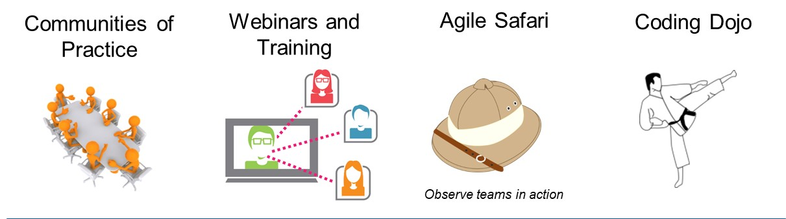
Build the Talent through Continuous Learning
Alset recognized the need for building a continuous learning collaborative environment
Notes:
From abstract: Share ways for building the skills, knowledge, and experience of the workers in a high collaborative environment
Reference Team Topologies (p. 67 Successful team patterns)
We will share lessons that take us from value stream identification to building teams in this new way of working. We will also share lessons for building teams that includes an environment where we create a learning and collaboration culture.

